Slide 1
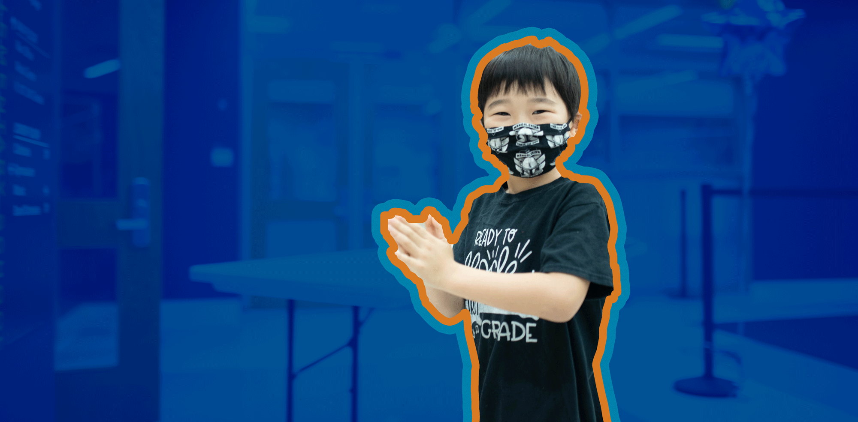
2021–2022 Quarantine Guidance for COVID-19: Health, Safety and Instructional Plans

Slide 2
Day One APS: Division of Academics FY22 Health and Safety Guidelines
Who Needs to Quarantine After Exposure to a Positive Case? | Who Doesn’t Need to Quarantine After Exposure?
People who are not vaccinated and have been in close contact with someone who has COVID-19. People who develop symptoms again within 3 months of their first bout of COVID-19. | People who have had COVID-19 within the past 3 months or who are fully vaccinated and not experiencing any symptoms. People who have tested positive for COVID-19 within the past 3 months and recovered do not have to quarantine or get tested again as long as they do not develop new symptoms. Note: Persons exposed to other persons who have been exposed do not need to quarantine.
What Counts as Close Contact? Close Contact through Proximity and Duration of Exposure: Someone who was within 6 feet of an infected person (laboratory-confirmed or a clinically compatible illness) for a cumulative total of 15 minutes or more over a 24-hour period (for example, three individual 5-minute exposures for a total of 15 minutes). An infected person can spread SARS-CoV-2 starting from 2 days before they have any symptoms (or, for asymptomatic patients, 2 days before the positive specimen collection date), until they meet criteria for discontinuing home isolation. Exception: In the K–12 indoor classroom setting, the close contact definition excludes students who were within 3 to 6 feet of an infected student (laboratory-confirmed or a clinically compatible illness) where both students were engaged in consistent and correct use of well-fitting masks; and other K–12 school prevention strategies (such as universal and correct mask use, physical distancing, increased ventilation) were in place in the K–12 school setting. (CDC, July 2021) This exception does not apply to teachers, staff, or other adults in the indoor classroom setting.
2

Slide 3
Day One APS: Division of Academics FY22 Health and Safety Guidelines
How Long does the Quarantine Last?
In collaboration with Fulton County Board of Health, Health Services will advise on how long quarantines should last, based on local conditions and needs.
School Nurses will address individual student and staff exposure cases. Whole class and Whole School exposures will be addressed by the Health Services Director.
Students/Staff may return from quarantine:
After day 10 without testing
After day 7 after receiving a negative test result (test must occur on day 5 or later)
After stopping quarantine, individuals should continue to watch for symptoms until 14 days after exposure.
3

Slide 4
Day One APS: Division of Academics FY22 Health and Safety Guidelines
How are positive cases or exposures reported?
Individuals who test positive for COVID OR who are exposed to a confirmed case should complete one of the links below for self-reporting:
Student self-report form: http://tinyAPS.com/?CovidStudentForm
Staff self-report form: http://tinyAPS.com/?CovidStaffForm

Slide 5
Day One APS: Division of Schools SY21-22 District Quarantine Instructional Guidance
CONDITION A AN ENTIRE CLASS IS QUARANTINED DUE TO COVID CASES/EXPOSURES (INCLUDING TEACHER) | A virtual or building-level designee will be assigned to deliver instruction virtually.
CONDITION B ​ONE OR MORE STUDENTS TEST POSITIVE FOR COVID ​(UNRELATED CASES) ONE OR MORE STUDENTS TEST POSITIVE FOR COVID WITH EXPOSURES TO OTHER STUDENTS WITHIN A CLASSROOM/​TEAM/GRADE LEVEL ​ A school has positive cases in different classes where there are no exposures within the spaces these students occupied Example: Teacher A – one student with COVID Teacher B – two students with COVID Teacher C – no students with COVID (Isolated cases throughout the building) | Teachers will make current academic work available virtually. A teacher/tutor will provide after school tutoring for students absent during the quarantine period. ​Designated virtual teachers/tutors and number of tutorial sessions will be determined by school-level administration based on need. A virtual learning tutorial schedule will be developed by the school and implemented over the course of the quarantine period. ​ Students who complete virtual assignments will be marked present.
5

Slide 6
Day One APS: Division of Schools SY21-22 District Quarantine Instructional Guidance
CONDITION C ​ TEACHER TESTS POSITIVE FOR COVID (NO EVIDENCE OF STUDENTS EXPOSURE) ​ | A long-term substitute or building-level designee will be assigned to the teacher’s classroom.​ Current substitute teacher plans will be used during the quarantine period for students affected. If the teacher is exposed and not ill, the teacher will provide instruction virtually.
CONDITION D Whole School/District Closure due to COVID Outbreak | Entire school pivots to virtual learning
6

